Slide 1


robability
Presented by
B mishra, pgt(maths)
Kv kunjaban, agartala

Slide 2

Goal
To Determine Basic Probability

Slide 3
PROBABILITY
The probability derived from the word “Probabilitas”, which means Probity- A measure of the authority of a witness in a legal case in Europe.
Probity- Goodness, honesty or integrity

Slide 4
History
For most of human history, probability, the formal study of the laws of chance, has been used for only one thing: gambling

Slide 5


It will ‘probably’ Rain today.
Can U say what is the chance ?

Slide 6


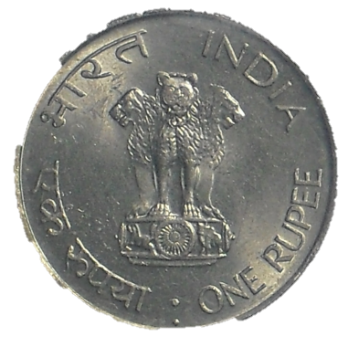
Flip / toss a coin
Can You say what is the exact outcome ?

Slide 7

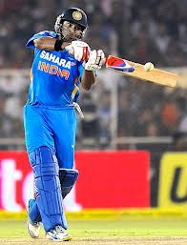
I doubt Yuvraj Singh will hit a six.
What is the ‘Chance’ that he will hit a six ?

Slide 8


Chances are high that the price of diesel will go up.
Can You say what is the chance ?

Slide 9

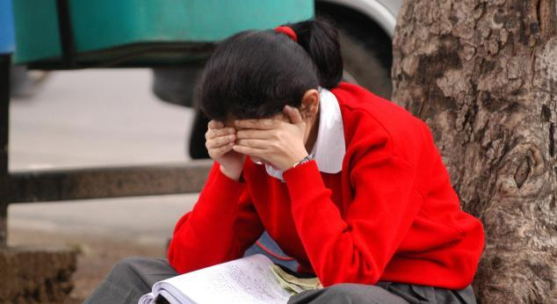
Sarita is going to appear SA-2 examination, Most probably she ‘may’ pass in the examination with CGPA 10.
What can you say about her passing with CGPA 10?

Slide 10
Where the words “probably”, “doubt”, “Chances” etc. are used there is an element of uncertainty. These uncertainty can be measured numerically by means of
‘ PROBABILITY’

Slide 11

Probability : How likely something is to happen.
Many events can't be predicted with total certainty. The best we can do is say how likely they are to happen, using the idea of probability.

Slide 12

Idea of Probability……….
Probability is the science of chance behavior
Chance behavior is unpredictable in the short run but has a regular and predictable pattern in the long run.

Slide 13

Random Experiment
All possible outcomes are known in advance.
The performance of the experiment is not known in advance
The experiment can be repeated under identical conditions.

Slide 14

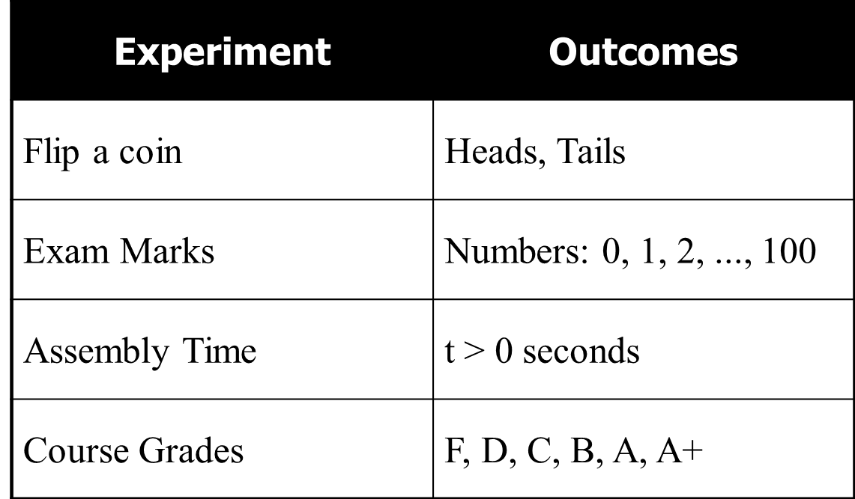
Random Experiment…
…a random experiment is an action or process that leads to one of several possible outcomes. For example:

Slide 15

Throwing a single Die
When a single die is thrown, there are six possible outcomes: 1, 2, 3, 4, 5, 6.
Interesting point
Many people think that one of these cubes is called "a dice". But no!
The plural is dice, but the singular is die: i.e. 1 die, 2 dice.

Slide 16

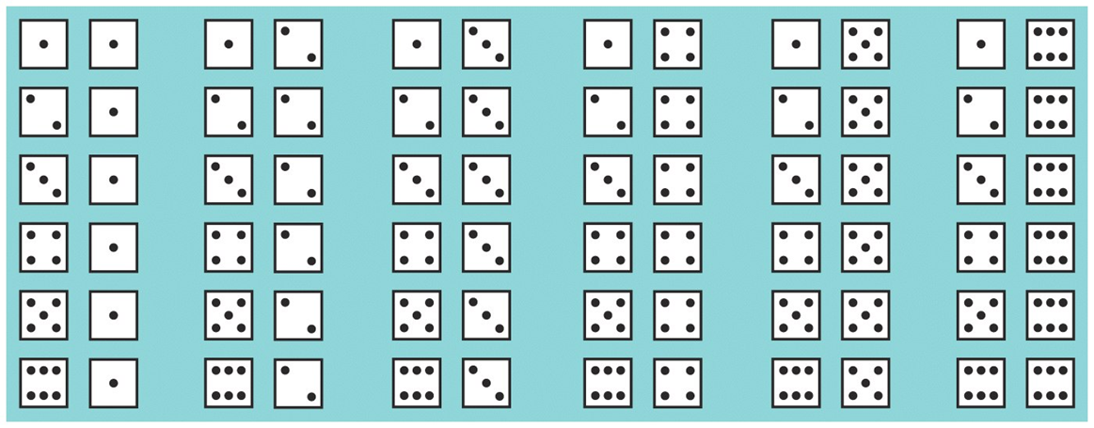
Probability Model for Two Dice

Slide 17

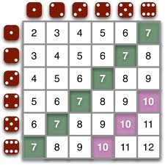
Roll a PAIR OF die & THEIR TOTAL SCORE
All possible outcomes

Slide 18
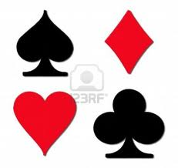
Introduction to playing cards
Spade
Dimond
Heart
Club

Slide 19
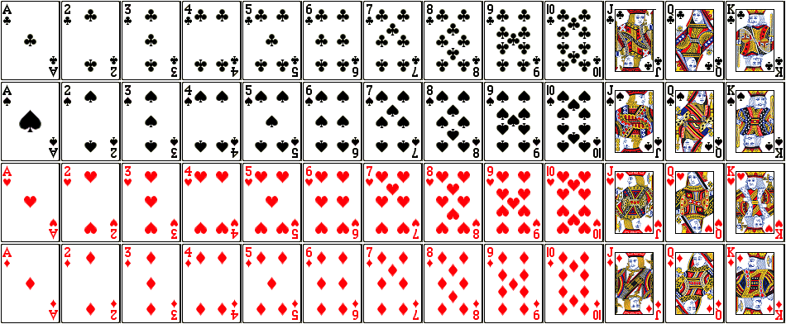
Four suits of 13 cards each

Slide 20

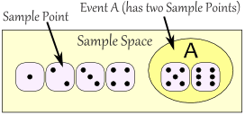
Sample space & Event
The sample space S of a random experiment is the set of all possible outcomes.
An event is an outcome or a set of outcomes (subset of the sample space).

Slide 21

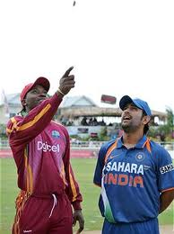
Sample Space…
The sample space is generally denoted by S.
The outcomes are denoted by O₁, O₂, …, O_{k}
Using notation from set theory, we can represent the sample space and its outcomes as: S = {O₁, O₂, …, O_{k}}
Example:
Experiment | Sample space
Tossing a coin once. Tossing a coin twice. Rolling a die once | S = { h, t} S = { hh, ht, th, tt} S= { 1, 2, 3, 4, 5, 6}

Slide 22
Events…
The EVENT is generally denoted by E.
Using notation from set theory, we can represent the event as a subset of the sample space:
Example:
Experiment | Event | Set notation
Tossing a coin once. Tossing a coin twice. Rolling a die once Rolling a die once | Getting a head. Getting exactly one tail. Getting prime numbers Getting odd numbers | E = { h } E = { ht, th } E = { 2, 3, 5 } E = { 1, 3, 5 }

Slide 23

Mathematical definition of probability
The Probability of an event represents the likelihood it will occur. Probability compares the favorable number of outcomes to the total number of outcomes.
Note: All the outcomes are equally likely
The Probability can be expressed as a fraction, decimal, or percentage.

Slide 24
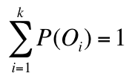
Requirements of Probabilities…
Given a sample space S = {O₁, O₂, …, O_{k}}, the probabilities assigned to the outcome must satisfy these requirements:
The probability of any outcome is between 0 and 1
i.e. 0 ≤ P(O_{i}) ≤ 1 for each i, and
The sum of the probabilities of all the outcomes equals 1
i.e. P(O₁) + P(O₂) + … + P(O_{k}) = 1
P(O_{i}) represents the probability of outcome i

Slide 25


Tossing a Coin
When a coin is tossed, there are two possible outcomes:
- heads (H) or tails (T)
We say that the probability of the coin landing H is ½.
And the probability of the coin landing T is ½.
Remember that: P(H) >0, P(T)>0 & P(H) + P(T) = 1

Slide 26

Rolling a die.
When a single die is thrown, there are six possible outcomes: 1, 2, 3, 4, 5, 6.
The probability of any one of them is 1/6.
P(1) + P(2) + P(3) + P(4) + P(5) + P(6) = 1

Slide 27
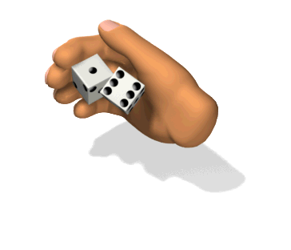
Rolling a pair of dice.
When a pair of dice is rolled, there are 36 possible outcomes: (1, 1), (1, 2), ………… ……………….., (6, 6).
The probability of any one of them is 1/36.

Slide 28

Classical Approach…
If an experiment has n possible outcomes [all equally likely to occur], this method would assign a probability of 1/n to each outcome.
Experiment: Rolling a die
Sample Space: S = {1, 2, 3, 4, 5, 6}
Probabilities: Each sample point has a 1/6 chance of occurring.
What about randomly selecting a student and observing their gender? S = {Male, Female}
Are these probabilities ½?

Slide 29

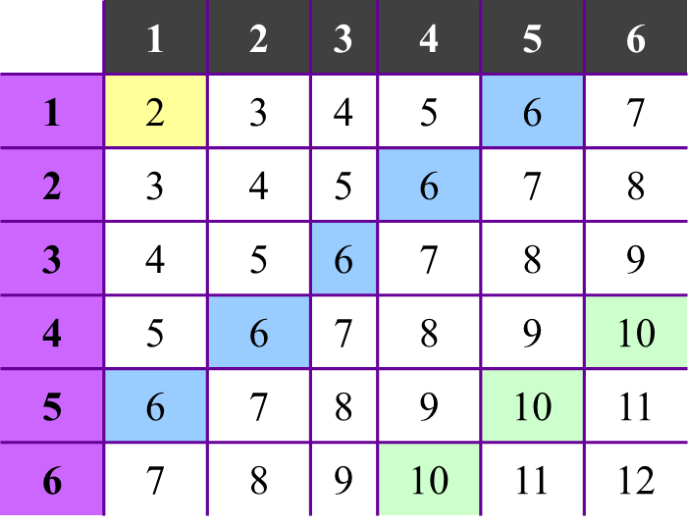
Classical Approach…
Experiment: Rolling 2 die [dice] and summing 2 numbers on top.
Sample Space: S = {2, 3, …, 12}
Probability Examples:
P(2) = 1/36
P(6) = 5/36
P(10) = 3/36

Slide 30

Probability Rule 1:
Any probability is a number between 0 and 1.
A probability can be interpreted as the proportion of times that a certain event can be expected to occur.
If the probability of an event is more than 1, then it will occur more than 100% of the time (Impossible!).

Slide 31

Probability Rule 2:
All possible outcomes together must have probability 1.
Because some outcome must occur on every trial, the sum of the probabilities for all possible outcomes must be exactly one.
If the sum of all of the probabilities is less than one or greater than one, then the resulting probability model will be incoherent(illogical).

Slide 32

Probability Rule 3:
If two events have no outcomes in common, they are said to be disjoint. The probability that one or the other of two disjoint events occurs is the sum of their individual probabilities.
Age of woman at first child birth
  under 20: 25%
  20-24: 33%
  25+: ?
} 24 or younger: 58%
Rule 3 (or 2): 42%

Slide 33
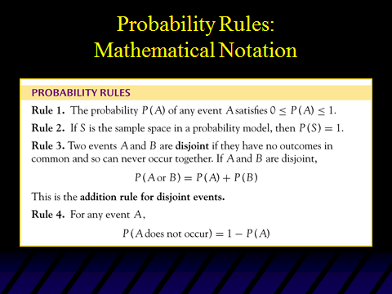

Slide 34

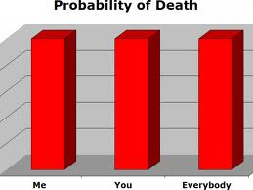
Probability of sure event is 1

Slide 35

Examples:
A bag contains 8 marbles numbered 1 to 8. We have to draw a ball from the bag at random.
Q.1. What is the sample space for this experiment?
Q.2. What is the probability of selection a 2 from the bag?
Q.3. What is the probability of selecting an odd number?
Q.4. What is the probability of selecting a number greater than 6?
Q.5. What is the probability of not selecting 2?

Slide 36

Solution:
A.1. S = { 1, 2, 3, 4, 5, 6, 7, 8}
A.2. E = { 2 }
A.3. E = { 1,3,5,7 }
A.4. E = { 7,8 }
A.5.

Slide 37

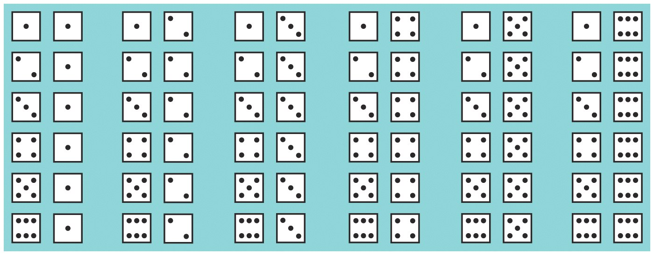
EXAMPLE
Random phenomenon: roll pair of fair dice and count the number of pips on the up-faces. Find the probability of rolling a 5.
P(roll a 5) = P( )+P( )+P( )+P( )
= 1/36 + 1/36 + 1/36 + 1/36
= 4/36
= 0.111

Slide 38
Some Interesting Questions
Is it possible that there is 53 Tuesday in a non-leap year? If yes, what is the probability?
Suppose six coins are flipped, what is the chance that of getting at least one tail?
Mr X has two children, and at least one of them is a girl. What is the probability that both children are girls?

Slide 39
Questions contd……..
4. My friend Mr X teaches at a school. One day he conducted a test for three of his students and when handed back the test papers, they had forgotten to write their names. Then Mr X returned the papers to the students at random. What is the probability that none of the three students will get the right papers?

Slide 40
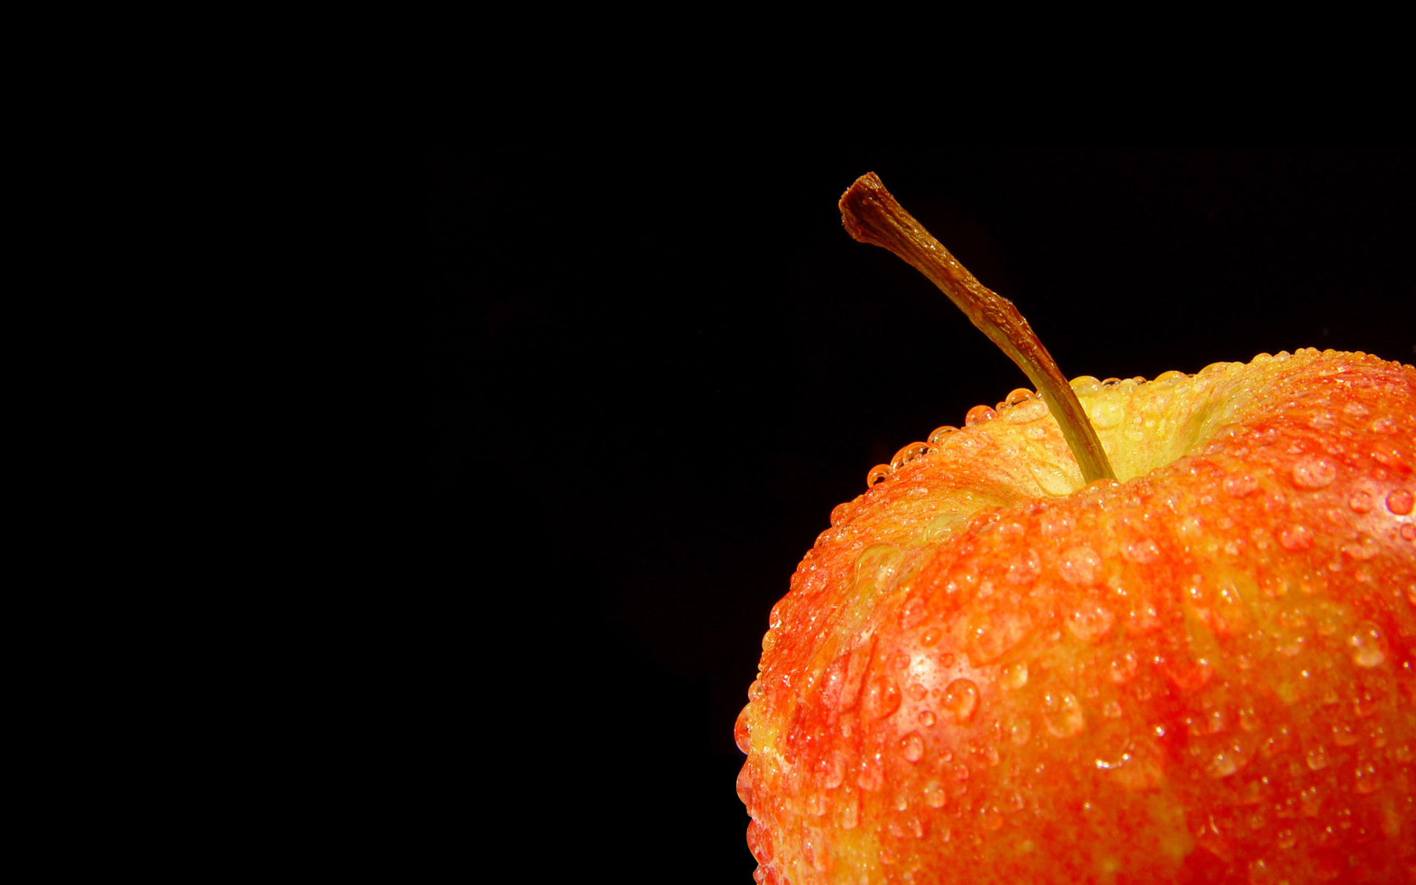
THE END

