Slide 1
Bio-data
Name-Swagnik Rana
Class-IX-B
Roll-34

Slide 2
Theorems
Theorem 10.1 : Equal chords of a circle subtend equal angles at the centre.
Theorem 10.2 : If the angles subtended by the chords of a circle at the centre are equal, then the chords are equal.
Theorem 10.3 : The perpendicular from the centre of a circle to a chord bisectsthe chord.
Theorem 10.4 : The line drawn through the centre of a circle to bisect a chord is perpendicular to the chord.
Theorem 10.5 : There is one and only one circle passing through three givennon-collinear points

Slide 3
Theorems
Theorem 10.6 : Equal chords of a circle (or of congruent circles) are equidistant
from the centre (or centres).
Theorem 10.7 : Chords equidistant from the centre of a circle are equal in
length.
10.8 : The angle subtended by an arc at the centre is double the angle
subtended by it at any point on the remaining part of the circle.
10.9 : Angles in the same segment of a circle are equal.
Theorem 10.10 : If a line segment joining two points subtends equal angles at
two other points lying on the same side of the line containing the line segment,
the four points lie on a circle (i.e. they are concyclic).
10.11 : The sum of either pair of opposite angles of a cyclic
quadrilateral is 180º.
Theorem 10.12 : If the sum of a pair of opposite angles of a quadrilateral is
180º, the quadrilateral is cyclic.

Slide 4
E.X.10.1
Q1: Fill in the blanks
(i) The centre of a circle lies in __________ of the circle. (exterior/ interior)
(ii) A point, whose distance from the centre of a circle is greater than its radius lies in __________ of the circle. (exterior / interior)
(iii) The longest chord of a circle is a __________ of the circle.
(iv) An arc is a __________ when its ends are the ends of a diameter.
(v) Segment of a circle is the region between an arc and __________ of the circle.
(vi) A circle divides the plane, on which it lies, in __________ parts.
(i) The centre of a circle lies in interior of the circle.
(ii) A point, whose distance from the centre of a circle is greater than its radius lies in exterior of the circle.
(iii) The longest chord of a circle is a diameter of the circle.
(iv) An arc is a semi-circle when its ends are the ends of a diameter.
(v) Segment of a circle is the region between an arc and chord of the circle.
(vi) A circle divides the plane, on which it lies, in three parts.

Slide 5
E.X.10.1
Q2: Write True or False. Give reasons for your answers.
(i) Line segment joining the centre to any point on the circle is a radius of the circle.
(ii) A circle has only finite number of equal chords.
(iii) If a circle is divided into three equal arcs, each is a major arc.
(iv) A chord of a circle, which is twice as long as its radius, is a diameter of the circle.
(v) Sector is the region between the chord and its corresponding arc.
(vi) A circle is a plane figure.
(i) True. All the points on the circle are at equal distances from the centre of the circle, and this distance is called as radius of the circle.
(ii) False. There are infinite points on a circle and we can draw infinite number of chords of given length. Hence, a circle has infinite number of equal chords.
(iii) False. Because of each arc, the remaining arc will have greater length.
(iv) True. Twice the length of radius of any circle is its diameter.
(v) False by virtue of its definition.
(vi) True. A circle is always two-dimensional figure which is also a part of a plane.

Slide 6
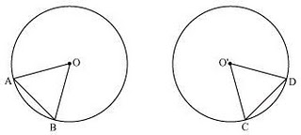
E.X.10.2
Q 1: Recall that two circles are congruent if they have the same radii. Prove that equal chords of congruent circles subtend equal angles at their centers.
A 'Circle' is an array of points which are equidistant from a fixed point. This fixed point is called as the 'Centre' of the circle and this equal distance is the 'Radius' of the circle. Therefore, if we try to superimpose two circles of equal radius, then both circles will cover each other. Therefore, two circles can be congruent only if, they have equal radii.
Consider two congruent circles having centre O and O' and two chords AB and CD of equal lengths.
In ΔAOB and ΔCO'D, we have -
AB = CD (Chords of same length)
OA = O'C (Radii of congruent circles)
OB = O'D (Radii of congruent circles)
Hence, ΔAOB ≅ ΔCO'D (by SSS congruence rule)
∠AOB = ∠CO'D (By CPCT)
Hence, it is proved that equal chords of congruent circles subtend equal angles at their centers.

Slide 7
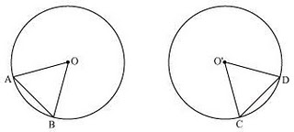
E.X.10.2
Q 2: Prove that if chords of congruent circles subtend equal angles at their centers, then the chords are equal.
Say, there are two congruent circles (circles of same radius) with centers as O and O' as shown in the following figure
In ΔAOB and ΔCO'D, we have -
∠AOB = ∠CO'D (Given)
OA = O'C (Radii of congruent circles)
OB = O'D (Radii of congruent circles)
Hence, ΔAOB ≅ ΔCO'D (by SSS congruence rule)
AB = CD (By CPCT)
Hence this is proved that if chords of congruent circles subtend equal angles at their centers, then the chords are equal.

Slide 8
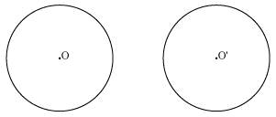
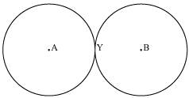
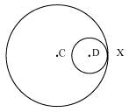
E.X.10.3
Q 1: Draw different pairs of circles. How many points does each pair have in common? What is the maximum number of common points?
Ans 1:
Consider the following pair of circles.
The above circles do not intersect each other at any point. Therefore, they do not have any point in common.

Slide 9
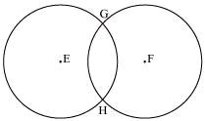
E.X.10.3
The above circles touch each other at 1 point X only. Therefore, the circles have 1 point in common.
These circles intersect each other at two points G and H. Therefore, the circles have two points in common. It can be observed that there can be a maximum of 2 points in common. Consider the situation in which two congruent circles are superimposed on each other. This situation can be referred to as if we are drawing the circle two times.

Slide 10
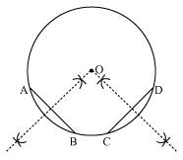
E.X.10.3
Q 2: Suppose you are given a circle. Give a construction to find its centre.
Ans 2:
The below given steps will be followed to find the centre of the given circle.
Step1. Take the given circle.
Step2. Take any two different chords AB and CD of this circle and draw perpendicular bisectors of these chords.
Step3. Let these perpendicular bisectors meet at point O. Hence, O is the centre of the given circle.

Slide 11
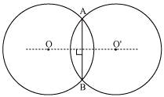
E.X.10.3
Q 3: If two circles intersect at two points, then prove that their centers lie on the perpendicular bisector of the common chord.
Ans 3:
Consider two circles centered at point O and O’, intersecting each other at point A and B respectively.
Join AB. AB is the chord of the circle centered at O. Therefore, perpendicular bisector of AB will pass through O.
Again, AB is also the chord of the circle centered at O’. Therefore, perpendicular bisector of AB will also pass through O’.
Clearly, the centers of these circles lie on the perpendicular bisector of the common chord.

Slide 12
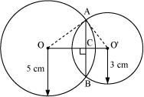
E.X.10.4
(1)Two circles of radii 5 cm and 3 cm intersect at two points and the distance between their centres is 4 cm. Find the length of the common chord.
Let the radius of the circle centered at O and O' be 5 cm and 3 cm respectively.
OA = OB = 5 cm
O'A = O'B = 3 cm
OO' will be the perpendicular bisector of chord AB.
∴ AC = CB
It is given that, OO' = 4 cm
Let OC be x. Therefore, O'C will be 4 − x.
In ΔOAC,
OA² = AC² + OC²
⇒ 5² = AC² + x²
⇒ 25 − x² = AC² ... (1)

Slide 13
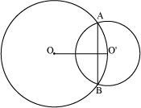
E.X.10.4
In ΔO'AC,
O'A² = AC² + O'C²
⇒ 3² = AC² + (4 − x)²
⇒ 9 = AC² + 16 + x² − 8x
⇒ AC² = − x² − 7 + 8x ... (2)
From equations (1) and (2), we obtain
25 − x² = − x² − 7 + 8x
8x = 32
x = 4
Therefore, the common chord will pass through the centre of the smaller circle i.e., O' and hence, it will be the diameter of the smaller circle.
AC² = 25 − x² = 25 − 4² = 25 − 16 = 9
∴ AC = 3 m
Length of the common chord AB = 2 AC = (2 × 3) m = 6 m

Slide 14
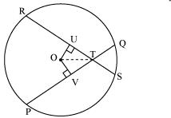
E.X.10.4
(2)If two equal chords of a circle intersect within the circle, prove that the segments of one chord are equal to corresponding segments of the other chord.
Let PQ and RS be two equal chords of a given circle and they are intersecting each other at point T.
Draw perpendiculars OV and OU on these chords.
In ΔOVT and ΔOUT,
OV = OU (Equal chords of a circle are equidistant from the centre)
∠OVT = ∠OUT (Each 90°)
OT = OT (Common)
∴ ΔOVT ≅ ΔOUT (RHS congruence rule)
∴ VT = UT (By CPCT) ... (1)
It is given that,
PQ = RS ... (2)
⇒
⇒ PV = RU ... (3)
On adding equations (1) and (3), we obtain
PV + VT = RU + UT
⇒ PT = RT ... (4)
On subtracting equation (4) from equation (2), we obtain
PQ − PT = RS − RT
⇒ QT = ST ... (5)
Equations (4) and (5) indicate that the corresponding segments of chords PQ and RS are congruent to each other.

Slide 15

E.X.10.4
(3)If two equal chords of a circle intersect within the circle, prove that the line joining the point of intersection to the centre makes equal angles with the chords.
Let PQ and RS are two equal chords of a given circle and they are intersecting each other at point T.
Draw perpendiculars OV and OU on these chords.
In ΔOVT and ΔOUT,
OV = OU (Equal chords of a circle are equidistant from the centre)
∠OVT = ∠OUT (Each 90°)
OT = OT (Common)
∴ ΔOVT ≅ ΔOUT (RHS congruence rule)
∴ ∠OTV = ∠OTU (By CPCT)
Therefore, it is proved that the line joining the point of intersection to the centre makes equal angles with the chords.

Slide 16
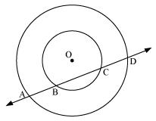
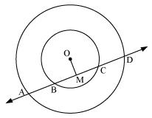
E.X.10.4
(4)If a line intersects two concentric circles (circles with the same centre) with centre O at A, B, C and D, prove that AB = CD (see figure 10.25).
Let us draw a perpendicular OM on line AD.
It can be observed that BC is the chord of the smaller circle and AD is the chord of the bigger circle.
We know that perpendicular drawn from the centre of the circle bisects the chord.
∴ BM = MC ... (1)
And, AM = MD ... (2)
On subtracting equation (2) from (1), we obtain
AM − BM = MD − MC
⇒ AB = CD

Slide 17
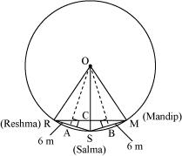

E.X.10.4
(5)Three girls Reshma, Salma and Mandip are playing a game by standing on a circle of radius 5 m drawn in a park. Reshma throws a ball to Salma, Salma to Mandip, Mandip to Reshma. If the distance between Reshma and Salma and between Salma and Mandip is 6 m each, what is the distance between Reshma and Mandip?
Draw perpendiculars OA and OB on RS and SM respectively.
OR = OS = OM = 5 m. (Radii of the circle)
In ΔOAR,
OA² + AR² = OR²
OA² + (3 m)² = (5 m)²
OA² = (25 − 9) m² = 16 m²
OA = 4 m
ORSM will be a kite (OR = OM and RS = SM). We know that the diagonals of a kite are perpendicular and the diagonal common to both the isosceles triangles is bisected by another diagonal.
∴∠RCS will be of 90° and RC = CM

Slide 18

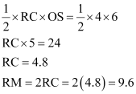
E.X.10.4
Area of ΔORS=
Therefore, the distance between Reshma and Mandip is 9.6 m

Slide 19
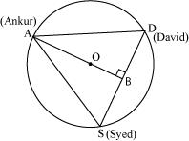
E.X.10.4
(6)A circular park of radius 20 m is situated in a colony. Three boys Ankur, Syed and David are sitFind the length of the string of each phone.
It is given that AS = SD = DA
Therefore, ΔASD is an equilateral triangle.
OA (radius) = 20 m
Medians of equilateral triangle pass through the circum centre (O) of the equilateral triangle ASD. We also know that medians intersect each other in the ratio 2: 1. As AB is the median of equilateral triangle ASD, we can write
∴ AB = OA + OB = (20 + 10) m = 30 m
In ΔABD,
AD² = AB² + BD²
AD² = (30)² +
Therefore, the length of the string of each phone will be m.
ting at equal distance on its boundary each having a toy telephone in his hands to talk each other.

Slide 20

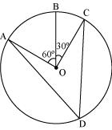
E.X.10.5
(1) In the given figure, A, B and C are three points on a cirAOB = 60°. If D is a point on the circle other than the arc ABC, find ∠ADC.
∠AOC = ∠AOB + ∠BOC
= 60° + 30°
= 90°
We know that angle subtended by an arc at the centre is double the angle subtended by it any point on the remaining part of the circle.

Slide 21
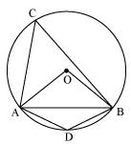

E.X.10.5
(2)A chord of a circle is equal to the radius of the circle. Find the angle subtended by the chord at a point on the minor arc and also at a point on the major arc.
In ΔOAB,
AB = OA = OB = radius
∴ ΔOAB is an equilateral triangle.
Therefore, each interior angle of this triangle will be of 60°.
∴ ∠AOB = 60°
In cyclic quadrilateral ACBD,
∠ACB + ∠ADB = 180° (Opposite angle in cyclic quadrilateral)
⇒ ∠ADB = 180° − 30° = 150°
Therefore, angle subtended by this chord at a point on the major arc and the minor arc are 30° and 150° respectively.

Slide 22
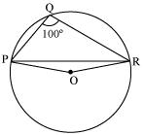
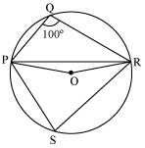
E.X.10.5
(3)In the given figure, ∠PQR = 100°, where P, Q and R are points on a circle with centre O. Find ∠OPR.
Consider PR as a chord of the circle.
Take any point S on the major arc of the circle.
PQRS is a cyclic quadrilateral.
∠PQR + ∠PSR = 180° (Opposite angles of a cyclic quadrilateral)
⇒ ∠PSR = 180° − 100° = 80°
We know that the angle subtended by an arc at the centre is double the angle subtended by it at any point on the remaining part of the circle.
∴ ∠POR = 2∠PSR = 2 (80°) = 160°
In ΔPOR,
OP = OR (Radii of the same circle)
∴ ∠OPR = ∠ORP (Angles opposite to equal sides of a triangle)
∠OPR + ∠ORP + ∠POR = 180° (Angle sum property of a triangle)
2 ∠OPR + 160° = 180°
2 ∠OPR = 180° − 160° = 20º

Slide 23
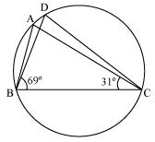
E.X.10.5
(4)In the given figure, ∠ABC = 69°, ∠ACB = 31°, find ∠BDC.
In ΔABC
∠BAC + ∠ABC + ∠ACB = 180° (Angle sum property of a triangle)
⇒ ∠BAC + 69° + 31° = 180°
⇒ ∠BAC = 180° − 100º
⇒ ∠BAC = 80°
∠BDC = ∠BAC = 80° (Angles in the same segment of a circle are equal)

Slide 24
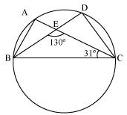
E.X.10.5
(5)In the given figure, A, B, C and D are four points on a circle. AC and BD intersect at a point E such that ∠BEC = 130° and ∠ECD = 20°. Find ∠BAC.
In ΔCDE
∠CDE + ∠DCE = ∠CEB (Exterior angle)
⇒ ∠CDE + 20° = 130°
⇒ ∠CDE = 110°
However, ∠BAC = ∠CDE (Angles in the same segment of a circle)
⇒ ∠BAC = 110°

Slide 25
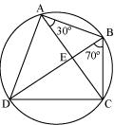
E.X.10.5
(6)ABCD is a cyclic quadrilateral whose diagonals intersect at a point E. If ∠DBC = 70°, ∠BAC is 30°, find ∠BCD. Further, if AB = BC, find ∠ECD.
For chord CD,
∠CBD = ∠CAD (Angles in the same segment)
∠CAD = 70°
∠BAD = ∠BAC + ∠CAD = 30° + 70° = 100°
∠BCD + ∠BAD = 180° (Opposite angles of a cyclic quadrilateral)
∠BCD + 100° = 180°
∠BCD = 80°
In ΔABC,
AB = BC (Given)
∴ ∠BCA = ∠CAB (Angles opposite to equal sides of a triangle)
⇒ ∠BCA = 30°
We have, ∠BCD = 80°
⇒ ∠BCA + ∠ACD = 80°
30° + ∠ACD = 80°
⇒ ∠ACD = 50°
⇒ ∠ECD = 50°

Slide 26

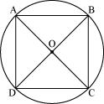

E.X.10.5
(7)If diagonals of a cyclic quadrilateral are diameters of the circle through the vertices of the quadrilateral, prove that it is a rectangle.
Let ABCD be a cyclic quadrilateral having diagonals BD and AC, intersecting each other at point O.
∠BCD + ∠BAD = 180° (Cyclic quadrilateral)
∠BCD = 180° − 90° = 90°
∠ADC + ∠ABC = 180° (Cyclic quadrilateral)
90° + ∠ABC = 180°
∠ABC = 90°
Each interior angle of a cyclic quadrilateral is of 90°. Hence, it is a rectangle

Slide 27
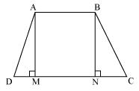
E.X.10.5
(8)If the non-parallel sides of a trapezium are equal, prove that it is cyclic.
Consider a trapezium ABCD with AB | |CD and BC = AD
Draw AM ⊥ CD and BN ⊥ CD.
In ΔAMD and ΔBNC,
AD = BC (Given)
∠AMD = ∠BNC (By construction, each is 90°)
AM = BM (Perpendicular distance between two parallel lines is same)
∴ ΔAMD ≅ ΔBNC (RHS congruence rule)
∴ ∠ADC = ∠BCD (CPCT) ... (1)
∠BAD and ∠ADC are on the same side of transversal AD.
∠BAD + ∠ADC = 180° ... (2)
∠BAD + ∠BCD = 180° [Using equation (1)]
This equation shows that the opposite angles are supplementary.
Therefore, ABCD is a cyclic quadrilateral.

Slide 28
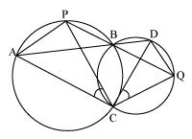
E.X.10.5
(9)Two circles intersect at two points B and C. Through B, two line segments ABD and PBQ are drawn to intersect the circles at A, D and P, Q respectively (see the given figure). Prove that ∠ACP = ∠QCD.
Join chords AP and DQ.
For chord AP,
∠PBA = ∠ACP (Angles in the same segment) ... (1)
For chord DQ,
∠DBQ = ∠QCD (Angles in the same segment) ... (2)
ABD and PBQ are line segments intersecting at B.
∴ ∠PBA = ∠DBQ (Vertically opposite angles) ... (3)
From equations (1), (2), and (3), we obtain
∠ACP = ∠QCD

Slide 29
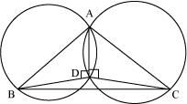
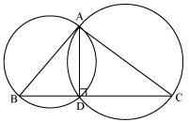
E.X.10.5
(10)If circles are drawn taking two sides of a triangle as diameters, prove that the point of intersection of these circles lie on the third side.
Consider a ΔABC.
Two circles are drawn while taking AB and AC as the diameter.
Let they intersect each other at D and let D not lie on BC.
Join AD.
∠ADB = 90° (Angle subtended by semi-circle)
∠ADC = 90° (Angle subtended by semi-circle)
∠BDC = ∠ADB + ∠ADC = 90° + 90° = 180°
Therefore, BDC is a straight line and hence, our assumption was wrong.
Thus, Point D lies on third side BC of ΔABC.

Slide 30
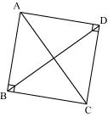
E.X.10.5
(11)ABC and ADC are two right triangles with common hypotenuse AC. Prove that ∠CAD = ∠CBD.
In ΔABC,
∠ABC + ∠BCA + ∠CAB = 180° (Angle sum property of a triangle)
⇒ 90° + ∠BCA + ∠CAB = 180°
⇒ ∠BCA + ∠CAB = 90° ... (1)
In ΔADC,
∠CDA + ∠ACD + ∠DAC = 180° (Angle sum property of a triangle)
⇒ 90° + ∠ACD + ∠DAC = 180°
⇒ ∠ACD + ∠DAC = 90° ... (2)
Adding equations (1) and (2), we obtain
∠BCA + ∠CAB + ∠ACD + ∠DAC = 180°
⇒ (∠BCA + ∠ACD) + (∠CAB + ∠DAC) = 180°
∠BCD + ∠DAB = 180° ... (3)
However, it is given that
∠B + ∠D = 90° + 90° = 180° ... (4)
From equations (3) and (4), it can be observed that the sum of the measures of opposite angles of quadrilateral ABCD is 180°. Therefore, it is a cyclic quadrilateral.
Consider chord CD.
∠CAD = ∠CBD (Angles in the same segment)

Slide 31
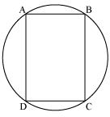
E.X.10.5
(12)Prove that a cyclic parallelogram is a rectangle.
Let ABCD be a cyclic parallelogram.
∠A + ∠C = 180° (Opposite angles of a cyclic quadrilateral) ... (1)
We know that opposite angles of a parallelogram are equal.
∴ ∠A = ∠C and ∠B = ∠D
From equation (1),
∠A + ∠C = 180°
⇒ ∠A + ∠A = 180°
⇒ 2 ∠A = 180°
⇒ ∠A = 90°
Parallelogram ABCD has one of its interior angles as 90°. Therefore, it is a rectangle.

